Slide 1

Chapter 1 Introduction
School of Computer Science and Engineering
Pusan National University
Jeong Goo Kim

Slide 2
Ch. 1: Outline
1.1 Data Communications
1.2 Networks
1.3 Network Types
1.4 Internet History
1.5 Standards and Administration

Slide 3
    1.1 DATA COMMUNICATIONS
    1.1 Data Communications
When we communicate, we are sharing information. This sharing can be local or remote. The term telecommunication, which includes telephony, telegraph, and television, means communication at a distance.
Data communications are the exchange of data between two devices via some form of transmission media.
Effectiveness of data communications system depends on
  Delivery
  Accuracy
  Timeliness (real-time communication)
  Jitter

Slide 4
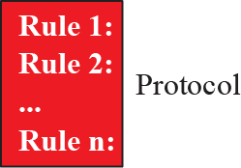
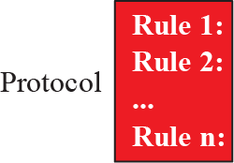
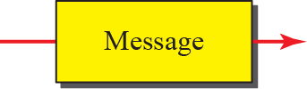


    1.1 DATA COMMUNICATIONS
    1.1.1 Components
Sender: device that send the message
Receiver: device that receive the message
Transmission medium: physical path for message sending
Message: information to be communicated
Protocol: a set of rules that govern data communications

Slide 5
    1.1 DATA COMMUNICATIONS
    1.1.2 Data Representation
Text
  Unicode, ASCII
Numbers (Appendix B)
Images
  JPEG, GIF
Audio
  PCM(8bits, 8kHz), CD(16bits, 44.1kHz), SACD(24bits, 2.82MHz)
Video
  MPEG, H.264

Slide 6
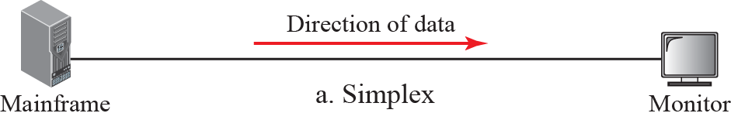
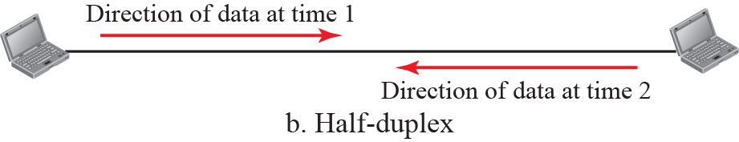
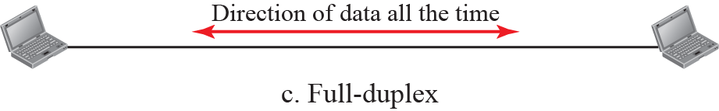
    1.1 DATA COMMUNICATIONS
    1.1.2 Data Flow

Slide 7
    1.2 NETWORKS
    1.2 NETWORKS
A network is the interconnection of a set of devices capable of communication
1.2.1 Network Criteria
Performance : throughput, delay
Reliability: frequency of failure, recovery time from a failure
Security:
  protecting data from unauthorized access
  Protecting data from damage and development etc.

Slide 8
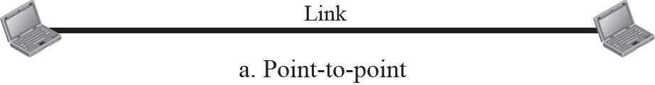
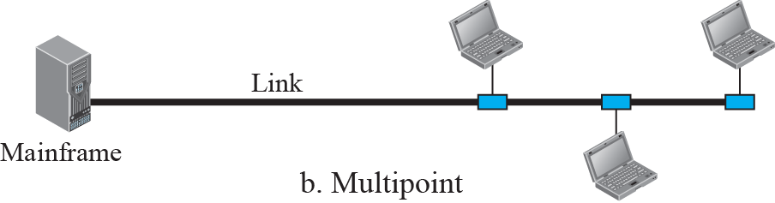
    1.2 NETWORKS
1.2.2 Physical Structures
Types of connection
  Point-to-point
  Multi point

Slide 9
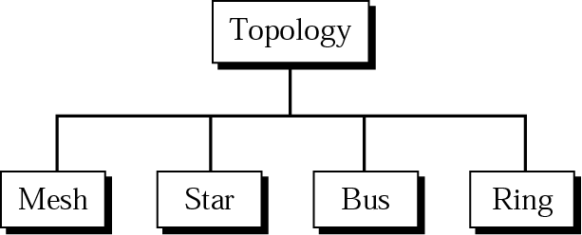
    1.2 NETWORKS
1.2.2 Physical Structures
Physical topology

Slide 10
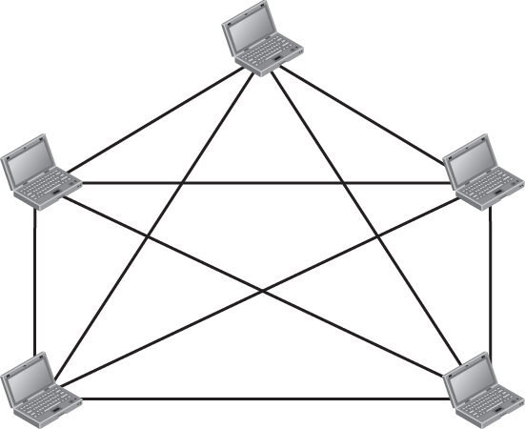


    1.2 NETWORKS
1.2.2 Physical Structures
Mesh topology
  Every device has a dedicated point-to-point link to every other device
  For n-device, n(n-1)/2 duplex links are needed
  (n-1) I/O ports
  Advantage
    Elimination the traffic problems
    due to use of dedicated links
    Robust
    Privacy or security
    Easy fault identification and isolation
  Disadvantage
    Amount of cabling and no. of I/O port
    Difficult installation and reconnection(expensive)

Slide 11
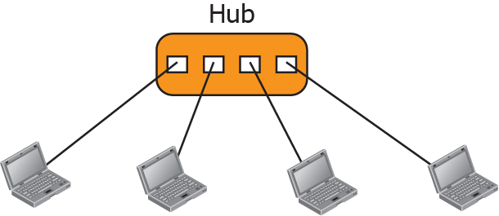
    1.2 NETWORKS
Star topology
  Each devices has a dedicated point-to-point link to Hub
  Not allowed direct traffic between devices.
  Less expensive than a mash
  1 channel per 1device
  1 I/O port is required

Slide 12
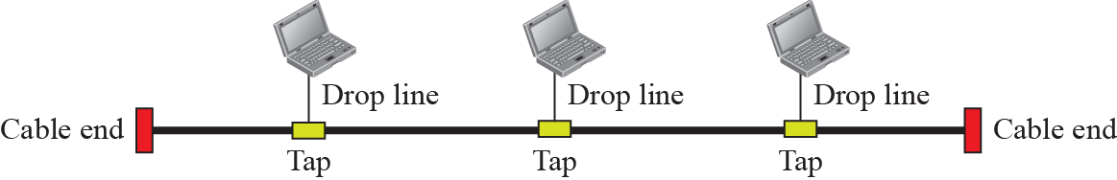
    1.2 NETWORKS
Bus topology
  Multipoint topology
  All devices are linked to Backbone
  By drop lines and taps nodes are connected to the bus.
  Advantage
    Easy to installation
  Disadvantage
    Difficult reconnection and fault isolation
    Backbone fault is fatal

Slide 13
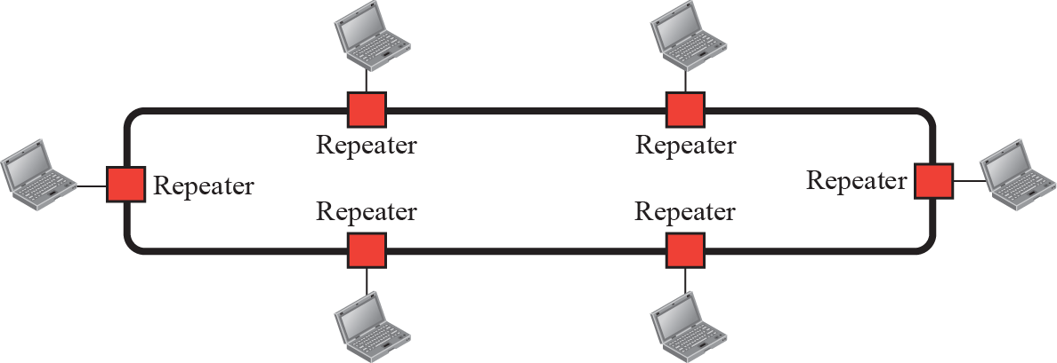
    1.2 NETWORKS
Ring topology
  Each device is point-to-point connected to only its neighbors
  Each device incorporates a repeater
  Advantage
    Easy to installation and reconnection
  Disadvantage
    In case of unidirectional, fault of ring can disable the entire network (dual ring)

Slide 14
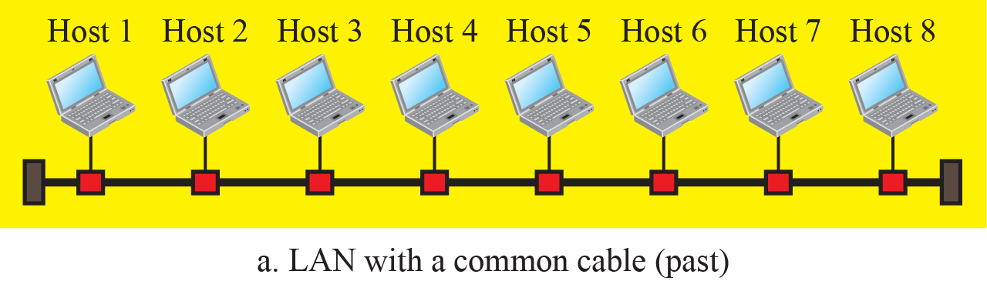
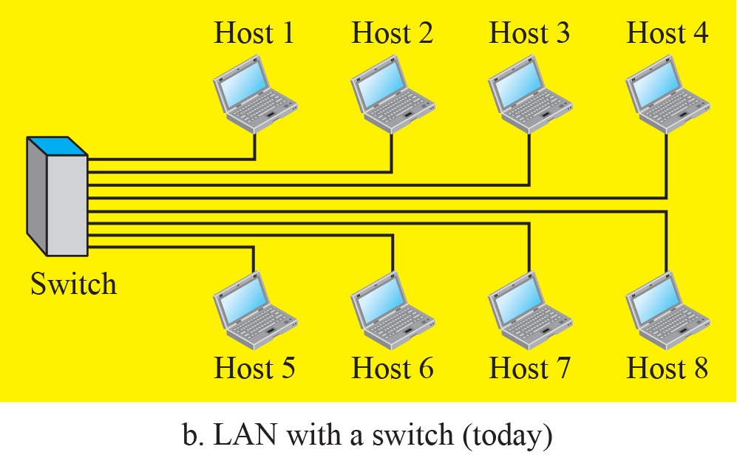
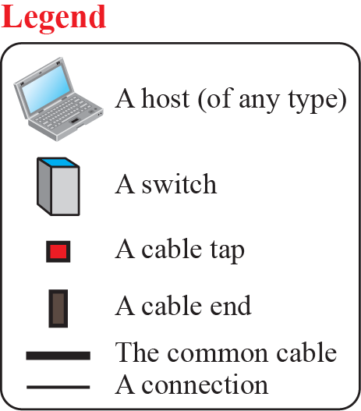
    1.3 NETWORKS TYPES
    1.3 NETWORKS TYPES
1.3.1 Local Area Networks
LAN is usually privately owned and connects some hosts in a single office, building, or campus

Slide 15
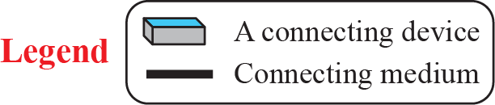
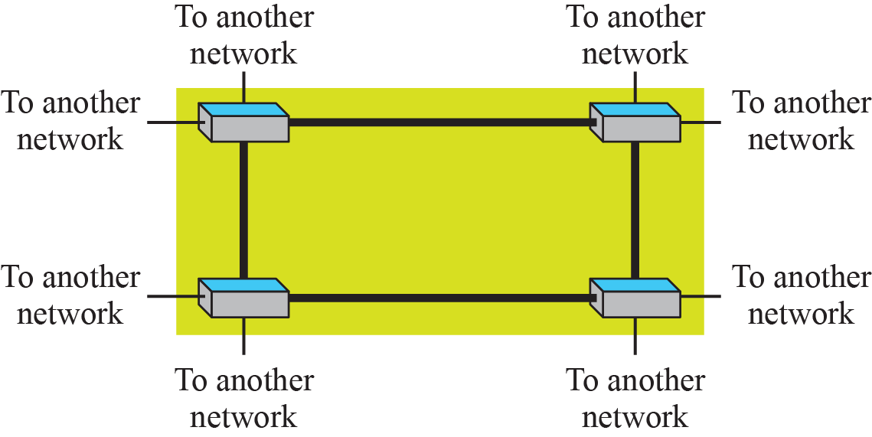
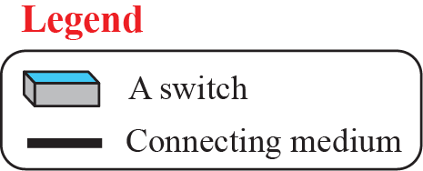
    1.3 NETWORKS TYPES
1.3.2 Wide Area Networks
WAN has a wider geographical span, spanning a town, a state, a country, or even the world
Point to point WAN
Switched WAN

Slide 16
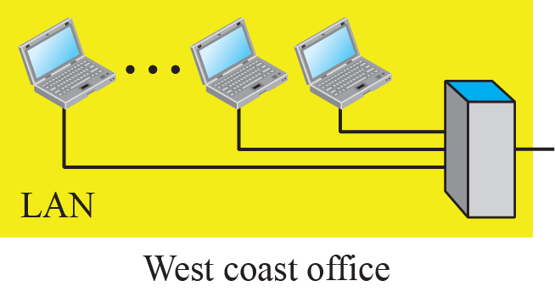
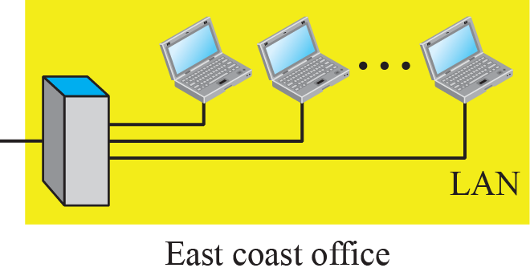
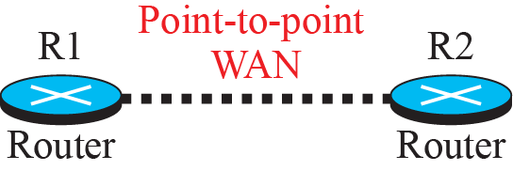

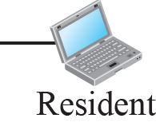
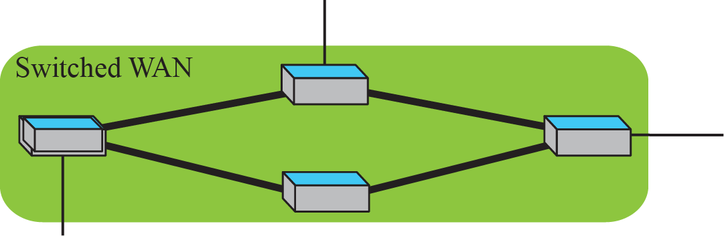
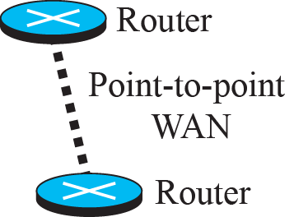
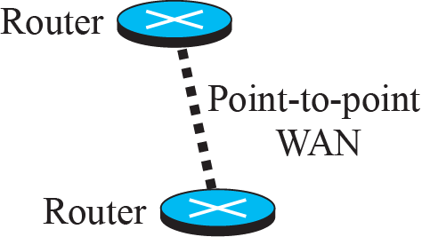
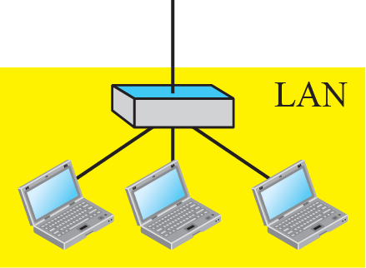
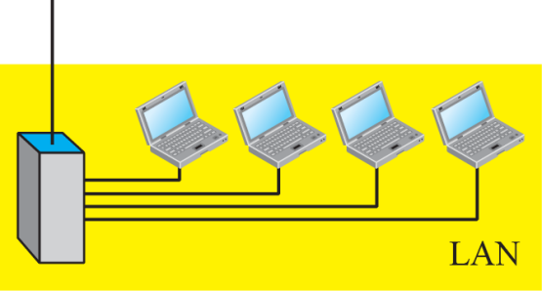
    1.3 NETWORKS TYPES
Internetwork
A heterogeneous network made of WANs and LANs

Slide 17
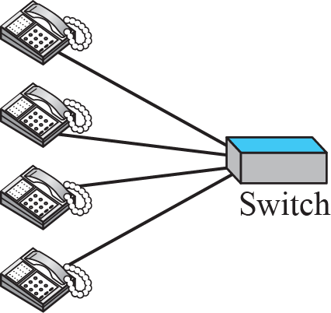
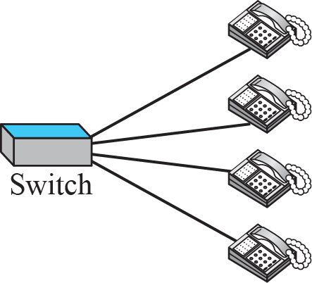

    1.3 NETWORKS TYPES
1.3.3 Switching
An internet is a switched network in which a switch connects at least two links together Point to point WAN
Circuit-Switched Network

Slide 18
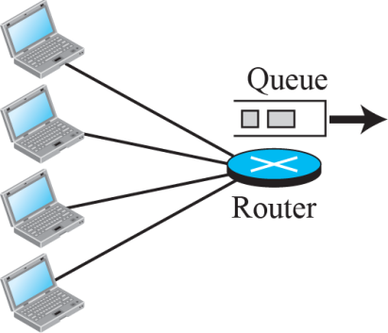
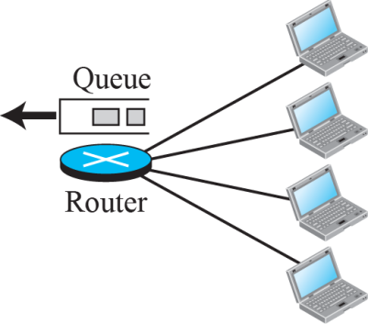

    1.3 NETWORKS TYPES
Packet-Switched Network

Slide 19
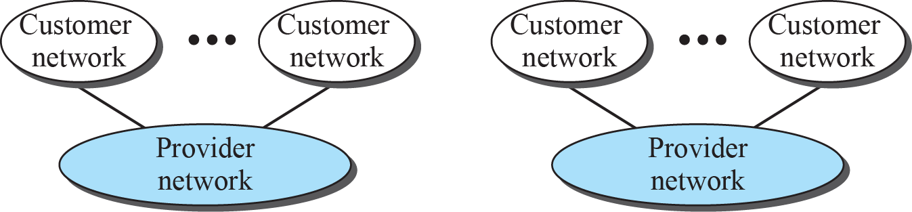
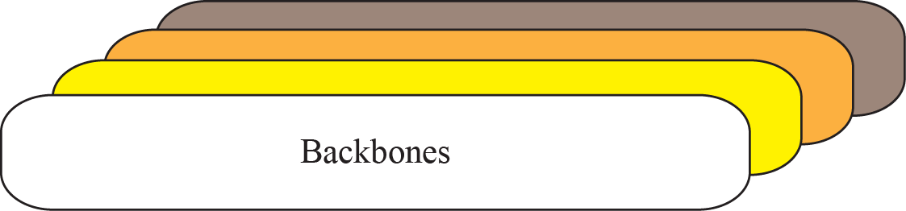
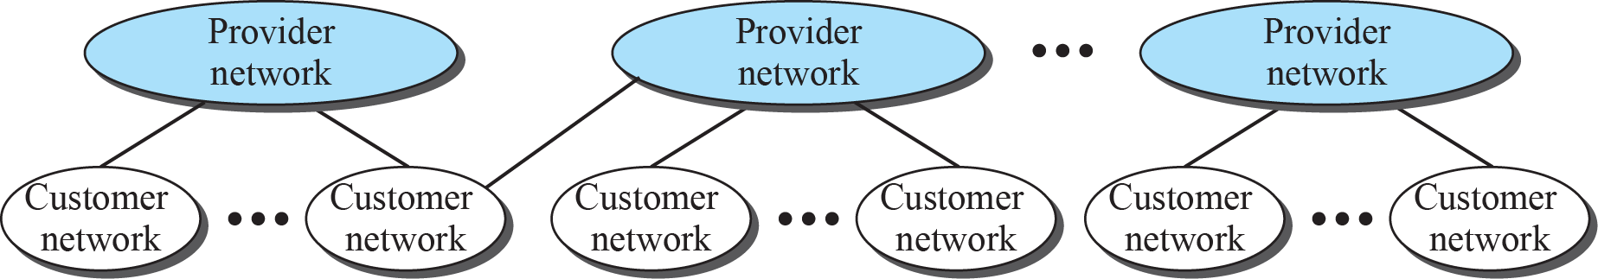
    1.3 NETWORKS TYPES
1.3.4 The Internet

Slide 20
    1.3 NETWORKS TYPES
1.3.5 Accessing the Internet
Using Telephone Networks
  Dial-up service
  DSL service
Using Cable Network
Using Wireless Network
Direct connection to the Internet

Slide 21
    1.4 INTERNET HISTORY
    1.4 INTERNET HISTORY
1.4.1 Early History
Birth of Packet-Switched Networks
  Leonard Kleinrock, MIT, 1961
ARPANET
  Advanced Research Projects Agency(ARPA)
  ARPANET, 1967
  By 1969, four nodes(UCLA, UCSB, SRI, U of Utah) were connected

Slide 22
    1.4 INTERNET HISTORY
1.4.2 Birth of the Internet
In 1972, Cerf and Kahn devised the idea of a gateway
TCP/IP
  In 1973, Cerf and Kahn proposed TCP(Transmission Control Protocol)
  In 1977, TCP split into TCP and IP(Internet Protocol)
MILNET
  In 1983, ARPANET split into Military Network and ARPANET
CSNET
  Computer Science Network, 1981
  Using TCP/IP

Slide 23
    1.4 INTERNET HISTORY
NSFNET
  In 1990, ARPANET was officially retired and replaced by NSFNET
ANSNET
  Advanced Network Services Network
  In 1991, IBM, Merit, and Verizon formed ANS to build ANSNET
1.4.3 Internet Today
World Wide Web
  1990, Tim Berners-Lee
Multimedia
    Voice over IP, Video over IP, You Tube, Television over IP
Peer-to-peer Application

Slide 24
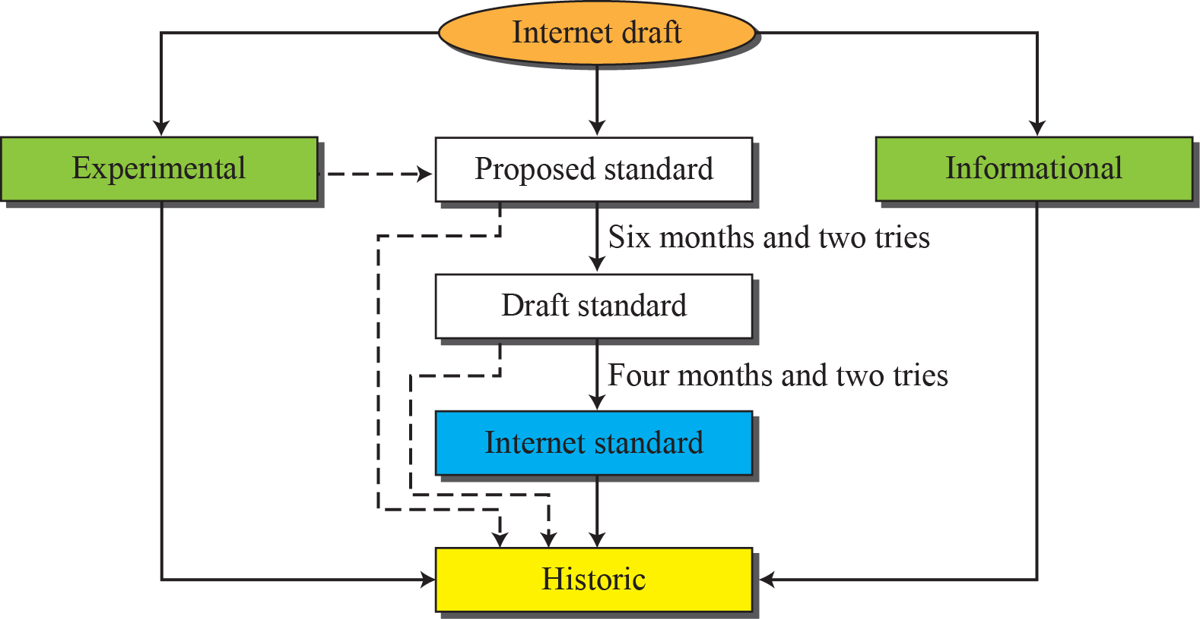
    1.5 STANDARDS AND ADMINISTRATION
    1.5 STANDARDS AND ADMINISTRATION
1.5.1 Internet Standards
Maturity levels of an RFC(Request for Comment)

Slide 25
    1.5 STANDARDS AND ADMINISTRATION
Requirement levels of an RFC
  Required
  Recommended
  Elective
  Limited Use
  Not Recommended

Slide 26
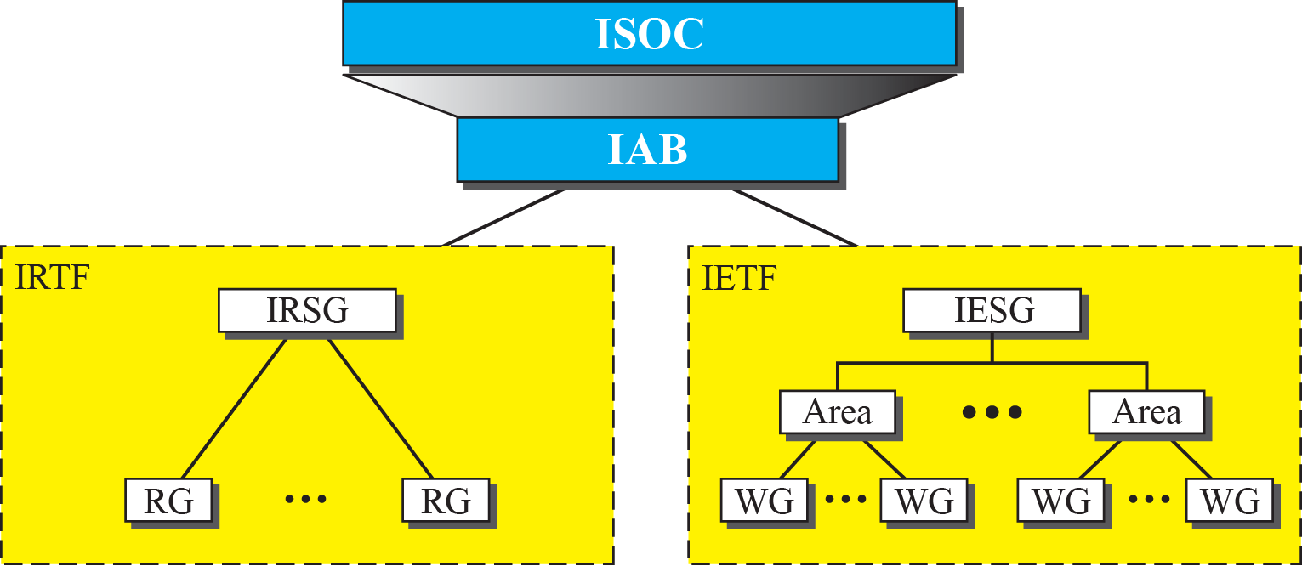
    1.5 STANDARDS AND ADMINISTRATION
1.5.2 Internet Administration
Internet Society (ISOC)
Internet Architecture Board (IAB)
IETF (Internet Engineering Task Force)
IRTF (Internet Research Task Force)

Slide 27
Homework
Homework
Read textbook pp. 31-47
Next Lecture
Chapter 2. Network Models

Slide 28
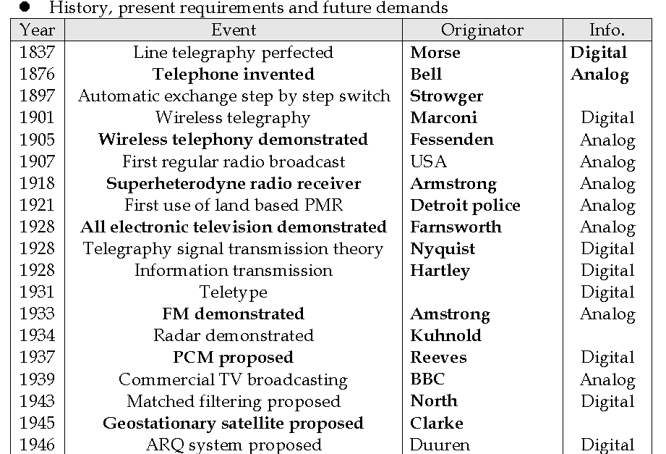
HISTORY

Slide 29
